Slide 1
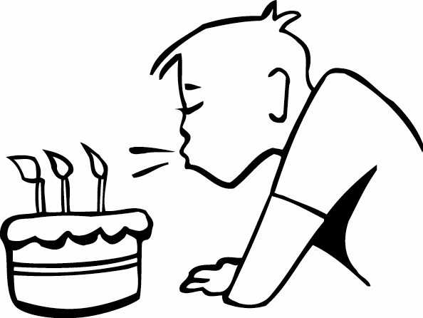
Bubble
Team 4 (Hun-Min Park, Sang-Gyun An, JongMin Jin)

Slide 2
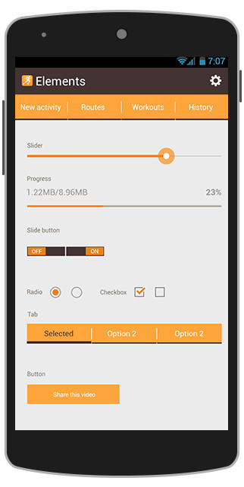
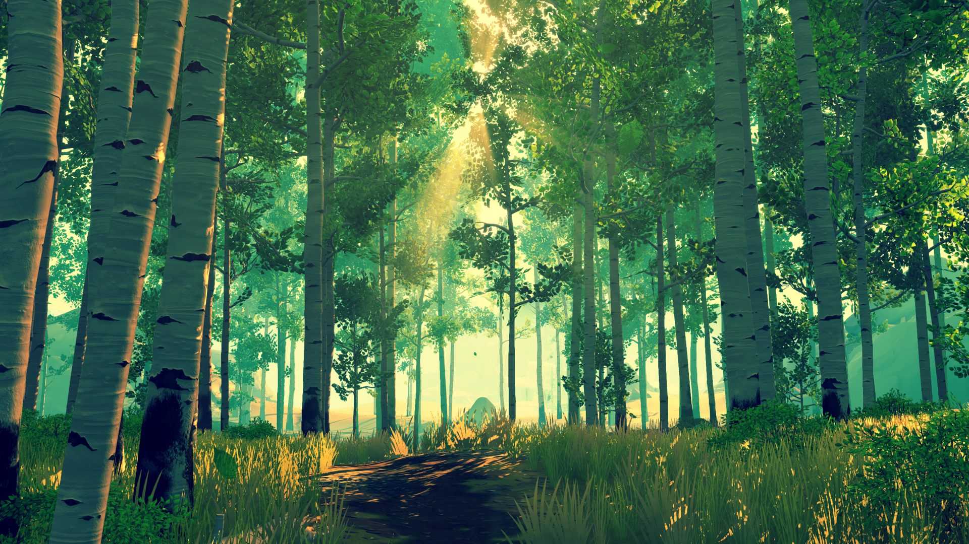



Start
Flying
Let’s blow a virtual bubble as far as you can!

Slide 3
Project schedule
Step 1
Project
Setup
Step 2
Basic graphics
&
physics
Step 3
Advanced graphics
Step 4
Alpha ver.
Step 5
Beta ver.
Presentation 1 (10/13)
Presentation 2
(11/03)
Presentation 3 (11/17)
Presentation 4
(12/01)
Final
(12/14)

Slide 4
Step 2: Basic graphics and physics
Advanced map generator
Environmental texture mapping
Collision detection
Spring-mass model

Slide 5
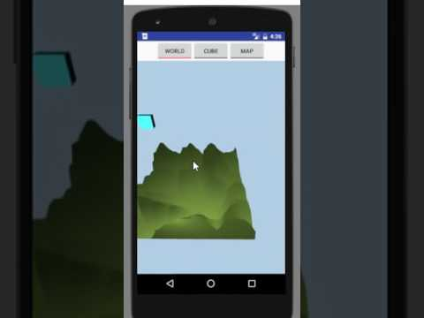
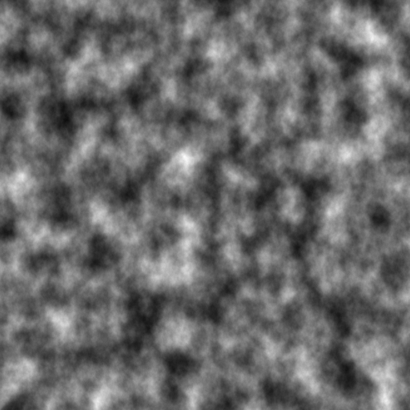
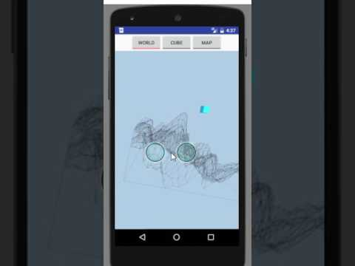
Advanced map generator
How
Perlin noise (gradient noise) * Ken Perlin. 1985. An image synthesizer. In Proceedings of the 12th annual conference on Computer graphics and interactive techniques (SIGGRAPH '85). ACM, New York, NY, USA, 287-296.
Trials
Diamond algorithm
etc.

Slide 6
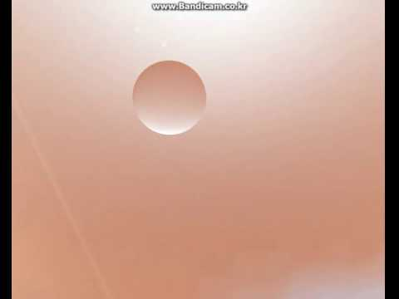
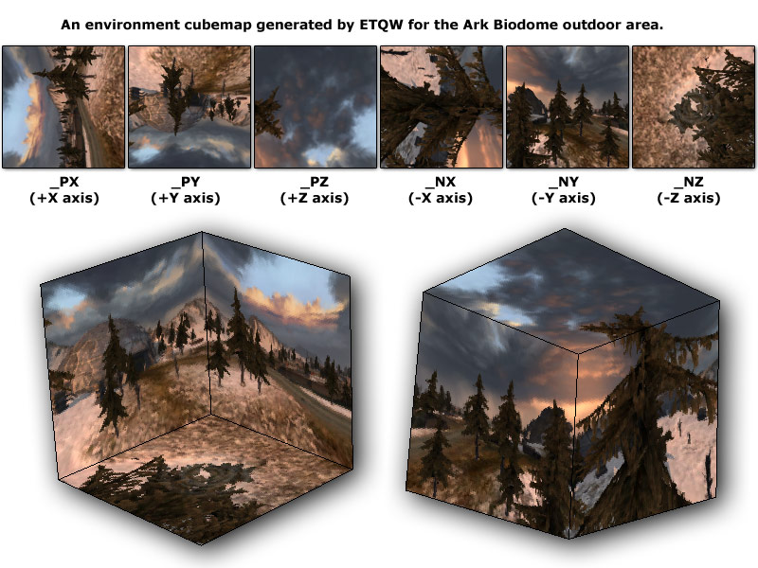
Environmental texture mapping
How
Cube maps

Slide 7
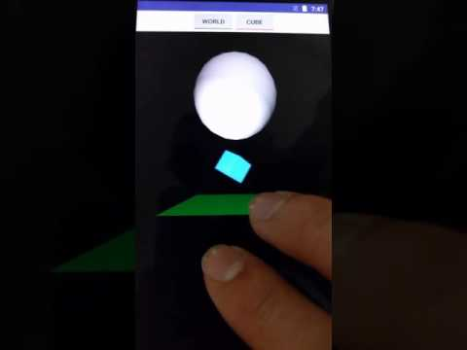
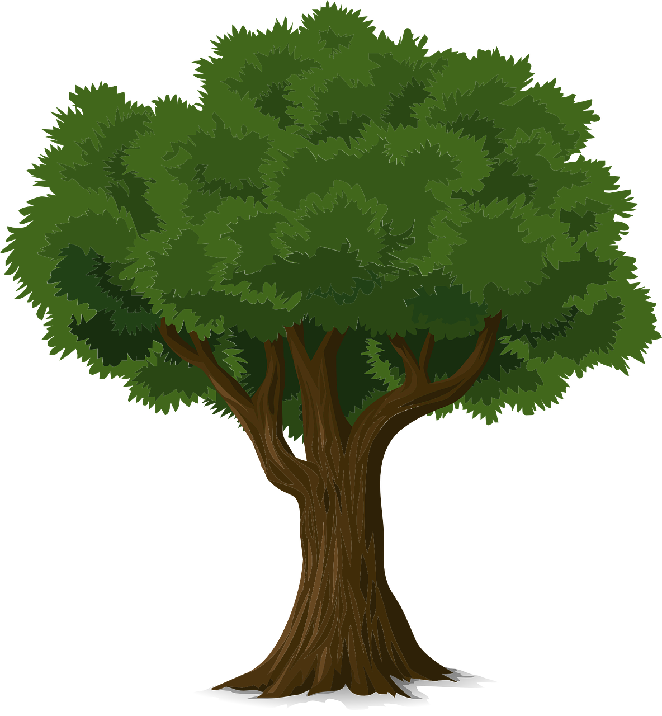

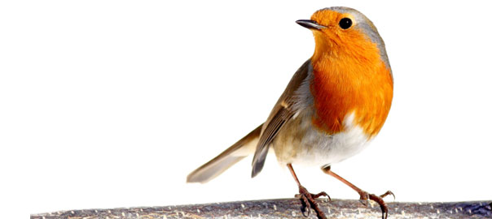
Collision detection
How
bounding box/sphere
3.4km

Slide 8
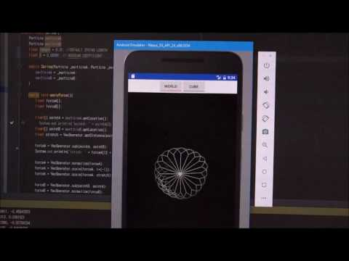
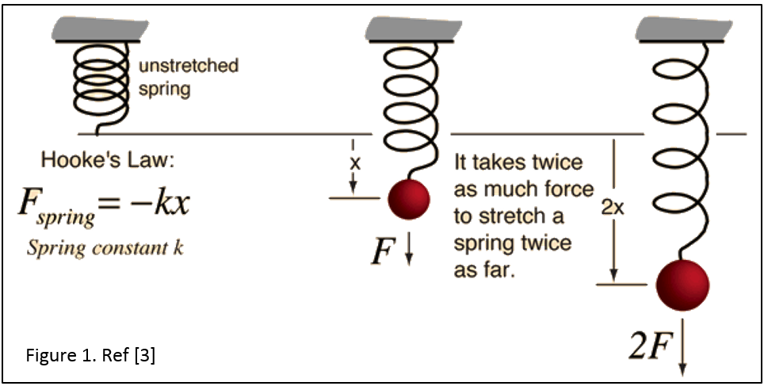
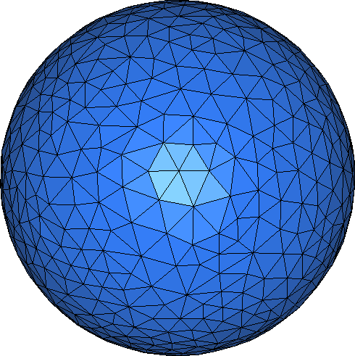
Spring-mass model
How
Spring-mass model
Future work
Dragging force to decrease oscillation.
Gravity.
Breath (wind) pressure.
etc.

Slide 9
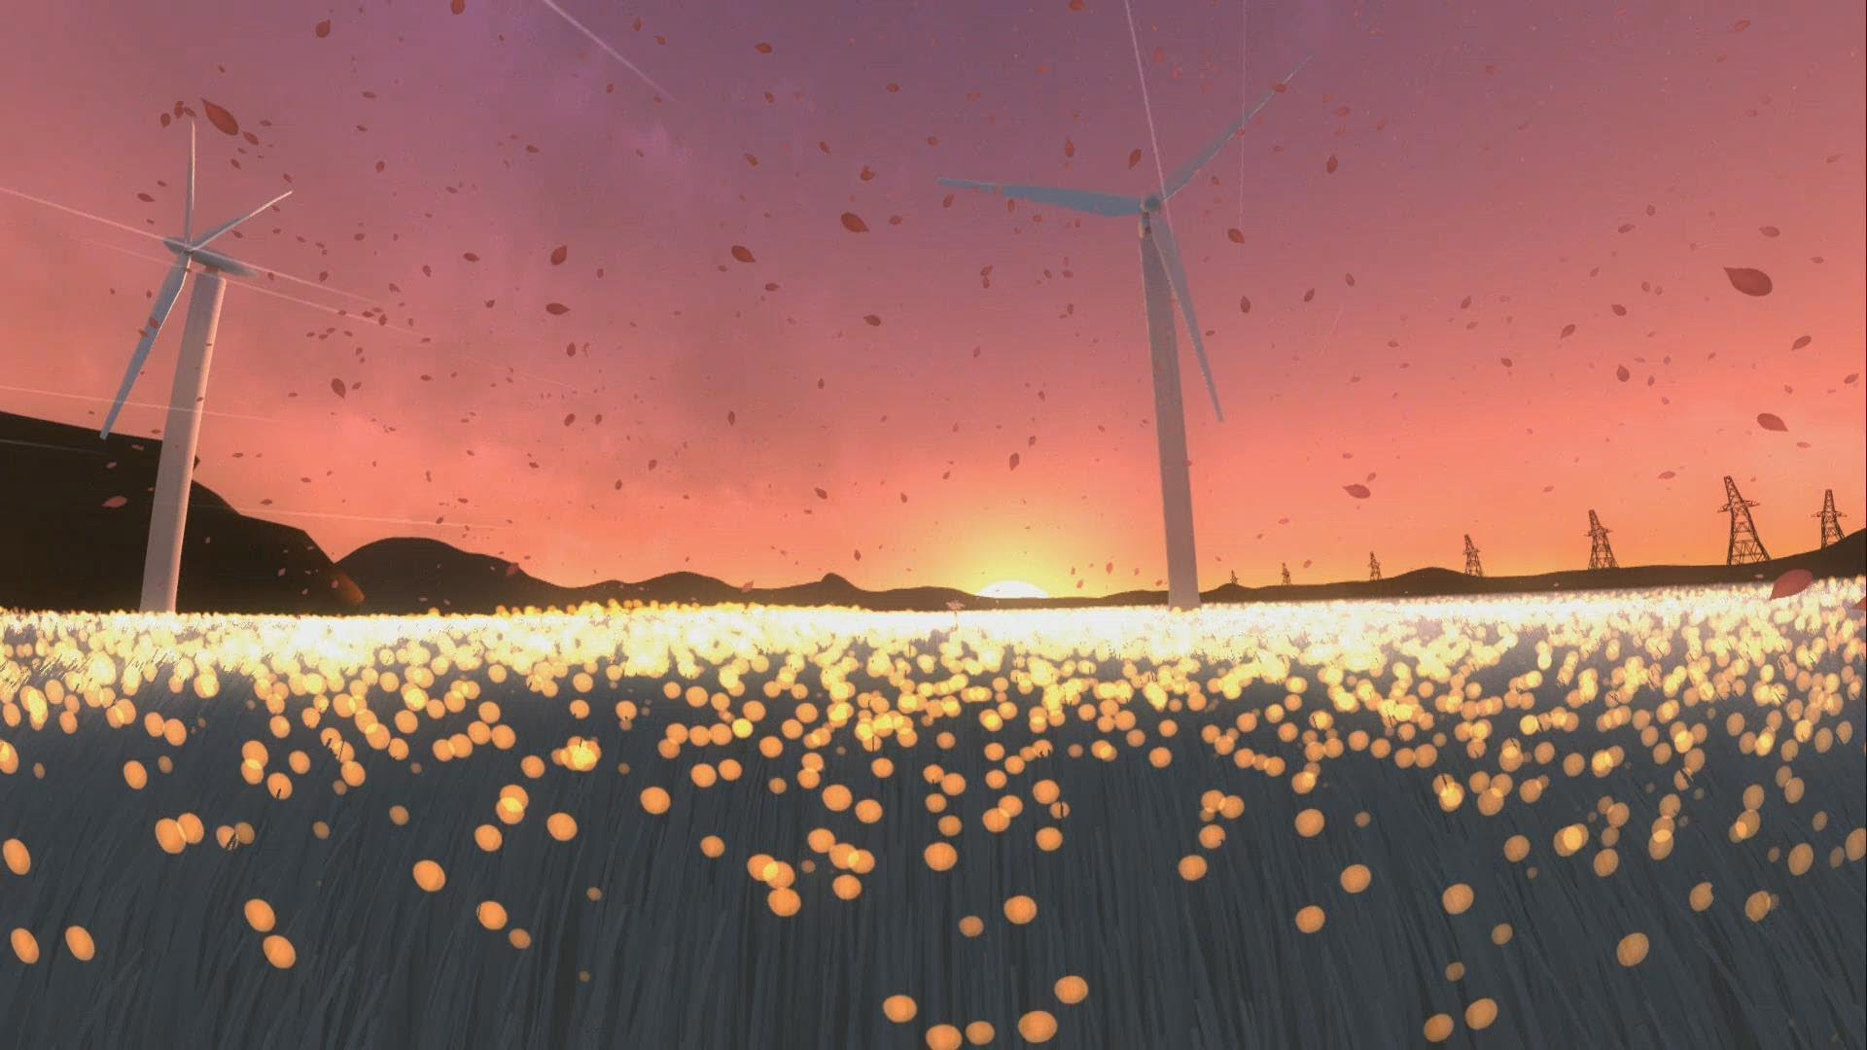
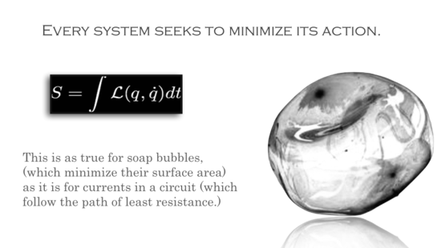
Next Step
Integrating independent modules
Map generator
Gyro handler for camera movement
Sound handler for bubble movement
Collision detector
Spring-mass model
Environmental texture mapping
Advanced graphics
Better appearance of bubble
Better atmosphere and map

Slide 10
Thank U

Slide 11
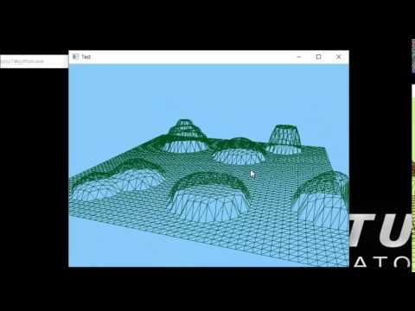
GL 3D world + Map generator
Draw a large square first.
Divide it into evenly-spaced small squares.
Pick a point P among the vertices. Let h and r height and radius of the ‘hill’.
For the points X = (x, y, z) such that |X-P| ≤ r, replace the value of y to y_new = max(h*exp(-(|X-P|/r)^2), y)
This makes a ‘hill’ on the map.
Modifying the formula gives us different kinds of hills. ex) ‘stairs’, ‘cliffs’, etc.

Slide 12
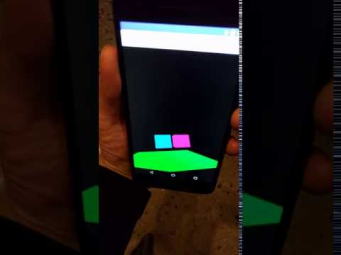
Rotate view by rotating Android device
Gyroscope sensor

Slide 13
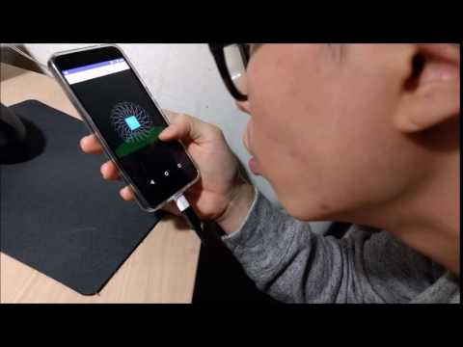
Move object by blowing
Android microphone → sound level → translation matrix

